Slide 1
Reciprocal Revolution
Welcome!
A Community Destination
With Community Impact
with Kevin Yoho
August 1, 2015
HSS 206 • 9:45-10:45

Slide 2
Whats a "Destination"?
A place people want to go to.

Slide 3
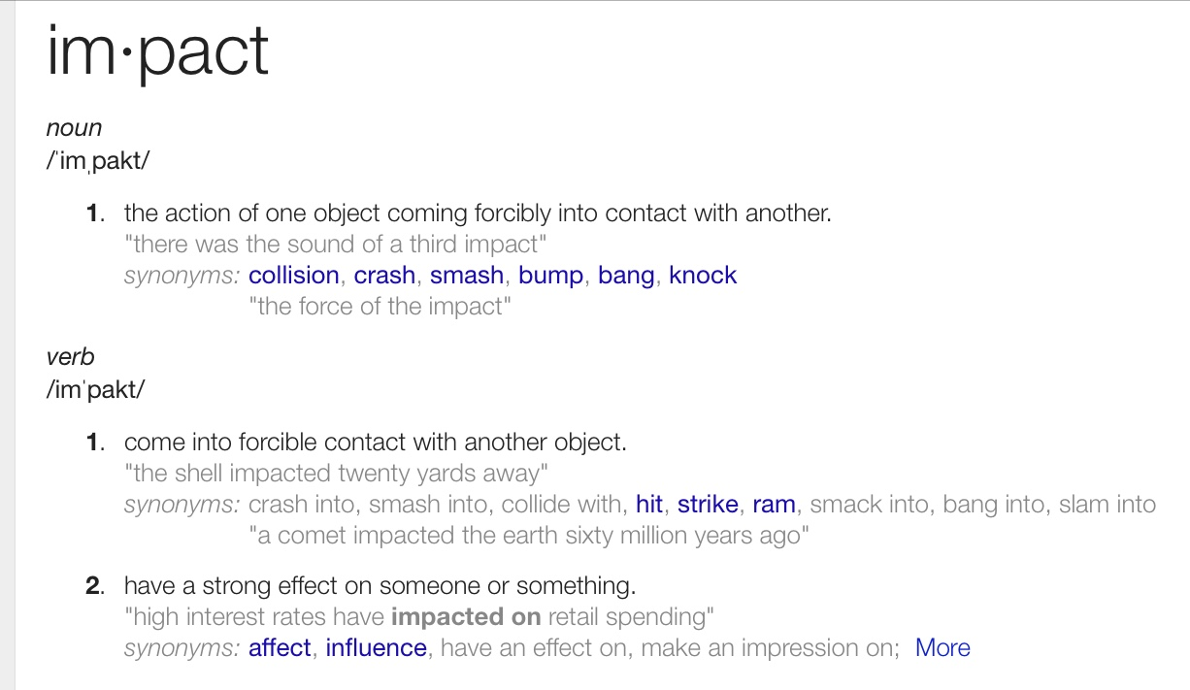
What's Impact?
Having a strong effect on someone or something.

Slide 4
Reciprocal Revolution: Making Your Church
A Community Destination
With Community Impact

Slide 5
Reciprocal Revolution
Resources From Today's Workshop available online.
www.reiprocalrevo.com

Slide 6
We Start Where We Are

Slide 7
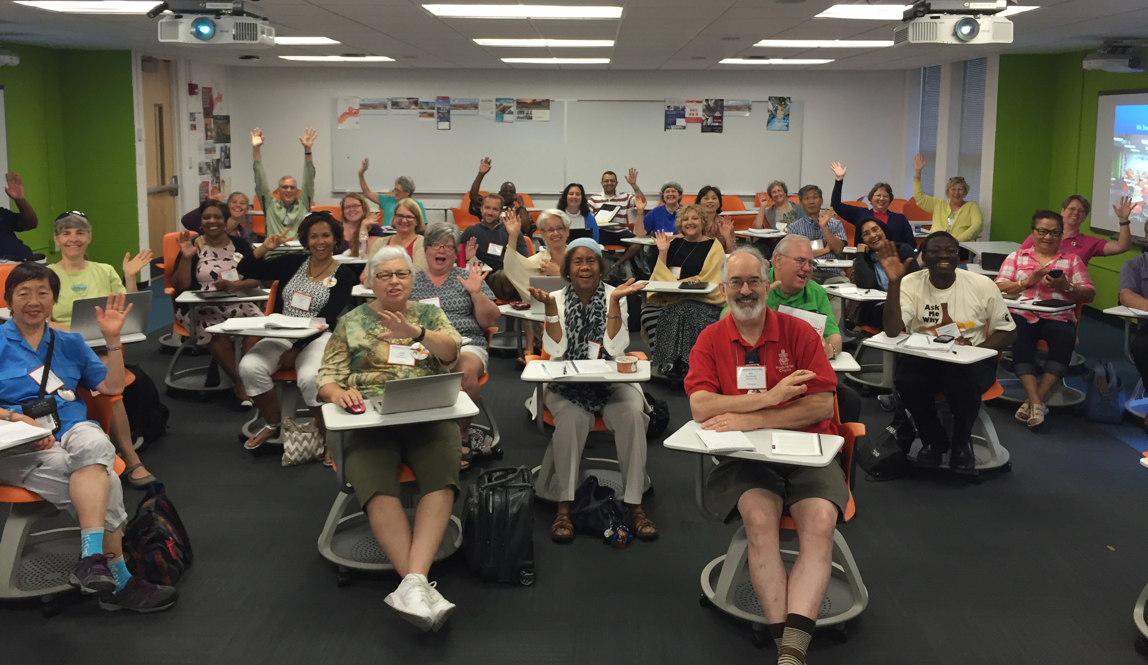
Thanks for being here today!

Slide 8
Favorite Bible Verse?
God so loved the world that God gave…
John 3:16

Slide 9
You Are Awesome
Thank You For Being With Us Today!
Celebrate Our Gifts
Let's Connect Our Spirits in Conversation

Slide 10
You are a gift to the world.
What are destinations in your community?

Slide 11
What We Measure, Says What Matters
How do you measure ministry health and effectiveness?
What mattered to Jesus?
Let’s take a look.
Notes:
How do you measure ministry> It's time to address our measurement system seriously.
What you we pay attention to? What do we value the most? In what ways have we grown? How have we changed? What have we learned?

Slide 12
John 1- Incarnation
Disrupted Planet
Notes:
The word became flesh and moved into out neighborhood.
John 1:14 The Word became flesh and made his dwelling among us. We have seen his glory, the glory of the One and Only, who came from the Father, full of grace and truth.

Slide 13
John 2- Temple cleansing
Disrupted Economy
Notes:
Ripping people off in the temple! No you don’t How dare you turn my Fathers house into a market!
John 2:14 In the temple courts he found men selling cattle, sheep and doves, and others sitting at tables exchanging money. 15 So he made a whip out of cords, and drove all from the temple area, both sheep and cattle; he scattered the coins of the money changers and overturned their tables.
16 To those who sold doves he said, “Get these out of here! How dare you turn my Father’s house into a market!”

Slide 14
John 3- Nicodemus
Disrupted Faith
Notes:
You must be born anew.
John 3:16 “For God so loved the world that he gave his one and only Son, that whoever believes in him shall not perish but have eternal life. 17 For God did not send his Son into the world to condemn the world, but to save the world through him.
25 An argument developed between some of John’s disciples and a certain Jew over the matter of ceremonial washing.

Slide 15
John 4- Samaritan Woman
Disrupted Gender and Race
Notes:
All genders and races worship in spirit and truth
John 4:23 Yet a time is coming and has now come when the true worshipers will worship the Father in spirit and truth, for they are the kind of worshipers the Father seeks.
John 4:27 Just then his disciples returned and were surprised to find him talking with a woman. But no one asked, “What do you want?” or “Why are you talking with her?”

Slide 16
John 5- Paralyzed man
Disrupted Justice
Notes:
No one is an invalid... in-valid, to Jesus.
John 5:1 Some time later, Jesus went up to Jerusalem for a feast of the Jews. 2 Now there is in Jerusalem near the Sheep Gate a pool, which in Aramaic is called Bethesda and which is surrounded by five covered colonnades. 3 Here a great number of disabled people used to lie—the blind, the lame, the paralyzed. 5 One who was there had been an invalid for thirty-eight years. 6 When Jesus saw him lying there and learned that he had been in this condition for a long time, he asked him, “Do you want to get well?”
18 For this reason the Jews tried all the harder to kill him; not only was he breaking the Sabbath, but he was even calling God his own Father, making himself equal with God.

Slide 17
John 6- Community feeding
Disrupted Planning and Priorities
Notes:
Food travels down the hill to feed many others. Time shifting.
John 6:5 When Jesus looked up and saw a great crowd coming toward him, he said to Philip, “Where shall we buy bread for these people to eat?” 6 He asked this only to test him, for he already had in mind what he was going to do.
John 6:66 From this time many of his disciples turned back and no longer followed him.
John 6:52 Then the Jews began to argue sharply among themselves, “How can this man give us his flesh to eat?”

Slide 18
John 7- Feast Nutrition
Disrupted Education
Notes:
Apparently Authentic and effective teachers are hard to find.
John 7:14 Not until halfway through the Feast did Jesus go up to the temple courts and begin to teach. 15 The Jews were amazed and asked, “How did this man get such learning without having studied?”
43 Thus the people were divided because of Jesus. 44 Some wanted to seize him, but no one laid a hand on him.

Slide 19
John 8- Caught in the act
Disrupted Morality
Notes:
Instead of the early Bible editors referring to this story as “A Woman Caught in Adultery” might better be called: Religious leaders Caught in Hypocrisy.
John 8:9 At this, those who heard began to go away one at a time, the older ones first, until only Jesus was left, with the woman still standing there. 10 Jesus straightened up and asked her, “Woman, where are they? Has no one condemned you?”
John 8:11 “No one, sir,” she said.
“Then neither do I condemn you,” Jesus declared. “Go now and leave your life of sin.”
John 8:58 “I tell you the truth,” Jesus answered, “before Abraham was born, I am!” 59 At this, they picked up stones to stone him, but Jesus hid himself, slipping away from the temple grounds.

Slide 20
John 9 (10)- Blind man
Disrupted Health Care
Notes:
Comprehensive health care was Jesus’ idea.
John 9:11 He replied, “The man they call Jesus made some mud and put it on my eyes. He told me to go to Siloam and wash. So I went and washed, and then I could see.”
22 His parents said this because they were afraid of the Jews, for already the Jews had decided that anyone who acknowledged that Jesus was the Christ would be put out of the synagogue.
John 9:34 To this they replied, “You were steeped in sin at birth; how dare you lecture us!” And they threw him out.

Slide 21
John 11- Dead man
Disrupted Death
Notes:
With Jesus, there’s life after death.
John 11:43 When he had said this, Jesus called in a loud voice, “Lazarus, come out!” 44 The dead man came out, his hands and feet wrapped with strips of linen, and a cloth around his face.
Jesus said to them, “Take off the grave clothes and let him go.”
47 Then the chief priests and the Pharisees called a meeting of the Sanhedrin.
“What are we accomplishing?” they asked. “Here is this man performing many miraculous signs. 48 If we let him go on like this, everyone will believe in him, and then the Romans will come and take away both our place and our nation.”
John 11:49 Then one of them, named Caiaphas, who was high priest that year, spoke up, “You know nothing at all! 50 You do not realize that it is better for you that one man die for the people than that the whole nation perish.”
John 11:51 He did not say this on his own, but as high priest that year he prophesied that Jesus would die for the Jewish nation, 52 and not only for that nation but also for the scattered children of God, to bring them together and make them one. 53 So from that day on they plotted to take his life.

Slide 22
John 12 (-17)- Jesus and Us
Disrupted Identity
Notes:
Jesus invests his time with people. Works. Prays. Prays for us!

Slide 23
John 18 (-20)- Jesus and the World
Disrupted Expectations
Notes:
The whole world has gone after Jesus. Heads to Jerusalem on purpose to die on a cross for us. This is why what those who say they follow Jesus matters so much. Is what we focus on congruent with the fact of the resurrection?

Slide 24
John 21- Jesus and the Future
Disrupted Destiny
Notes:
Both Judas and Peter made some bad mistakes. Judas thoguht there was no hope for him. There is hope Judas. Meet Peter. Faithlessness is restored by the risen Christ.

Slide 25
Equilibrium or Disruption?
Jesus Disrupts!
Notes:
The church needs disruption to be renewed.
Jesus completely disrupted what was not working, beyond repair, and unacceptable, to give life in abundance. Self-serving devotees of entrenched, incumbent leadership were targeted for transformational change. Instead of sustaining equilibrium, Jesus disrupted life on a grand scale.
That has become increasingly important to me.

Slide 26
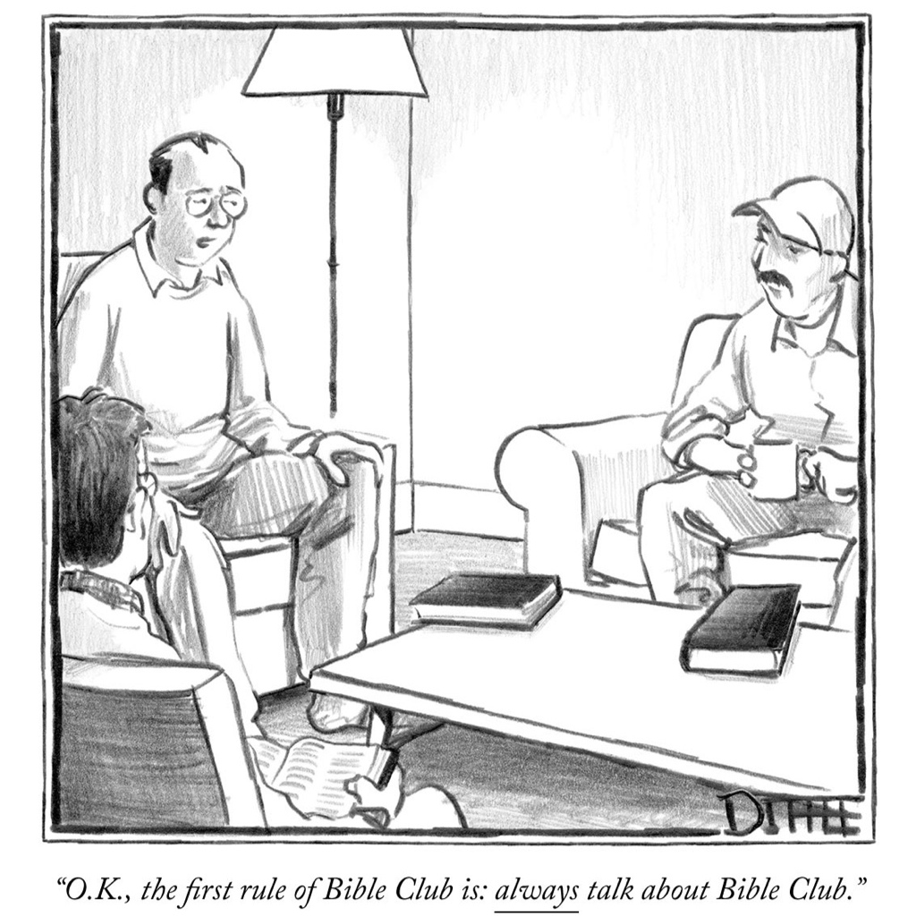
First rule of Bible Club is:
Always talk about Bible Club .
Notes:
For God so loved the... right. Not the church.
The first rule of Bible Club is to always talk about Jesus in the world.

Slide 27
We have to talk about the community, too!

Slide 28
History is a collection of stories.
We measure what matters to us using
METRICS

Slide 29
Number of churches
Number of members
Notes:
For the church, our scorecards show what really important to us. We can’t be renewed if we are focused on the unimportant indicators. They can be proxies for the important.

Slide 30
Equity Holders?
Stakeholders?
Notes:
Follow the money. If we want to measure the value of a person, or a family, or a business, or a church, we must measure the value creation and take into account the benefits perceived by all stakeholders, not just equity holders.

Slide 31
Is your church supported by the government?
Notes:
Is your church
supported by
the government?
Government support?
No.
Of course not.
Does your church pay property taxes?
Property Taxes?
No.
Not at all.

Slide 32
Does your church pay property taxes?
Notes:
Is your church
supported by
the government?
Government support?
No.
Of course not.
Does your church pay property taxes?
Property Taxes?
No.
Not at all.

Slide 33
Do You Know?
36
Churches property tax exemption exceeds:
$2,000,000
Per Year !
Notes:
The equivalent exemption in property taxes for the presbytery’s thirty-eight congregational sites exceeds…$2,000,000 each year!
$54,000 per year per church gift by community!

Slide 34
Your Church’s Tax Exemption
Establishes a financial contract with the community
Assumes community engagement by your church
Presumes a sense of community within your church
Notes:
Decades ago, it was clear that any church in the community added value to the community that could be measured as social capital. Tax exemption can only be understood in light of the principle of reciprocity.
The notion of tax exemption for church property is an old one. Genesis 47:26 records Pharaoh exempting the priests’ land from taxation, and Ezra 7:14 indicates that none of the priests, Levites, singers, porters or ministers of the house of God were to be charged tax, toll or custom. In the days of Roman Emperor Constantine, church buildings and the land surrounding them were exempt. Centuries later, European countries continued the tradition of exemption, albeit because the church frequently controlled the state.
In the U.S., property tax exemption for churches began in colonial days and continued with the birth of the new nation. In 1802, for instance, the Seventh Congress specifically exempted religious bodies from real estate taxes. On the state level, specific exemptions from property taxes for churches were established in Virginia in 1777, New York in 1799, and the city of Washington in 1802. "The exemptions [for churches have continued uninterrupted to the present day," Justice William 3. Brennan has said. ‘They are in force in all 50 states" (quoted by Leo Pfeffer in "The Special Constitutional Status of Religion," Taxation and the Free Exercise of Religion, edited by John Baker [Baptist Joint Committee on Public Affairs, 1978], p. 711).

Slide 35
Remember the Stakeholders! (community)
Notes:
Follow the money. If we want to measure the value of a person, or a family, or a business, or a church, we must measure the value creation and take into account the benefits perceived by all stakeholders, not just equity holders.

Slide 36
Where’s the Evidence?
Most congregations return something to the community.
How can measure our success?
How can we do more?
Notes:
Most congregations return something to the community. The missional challenge is to invite every congregation to be accountable in their ministry and mission to give, in a reciprocal way, to their own community.

Slide 37
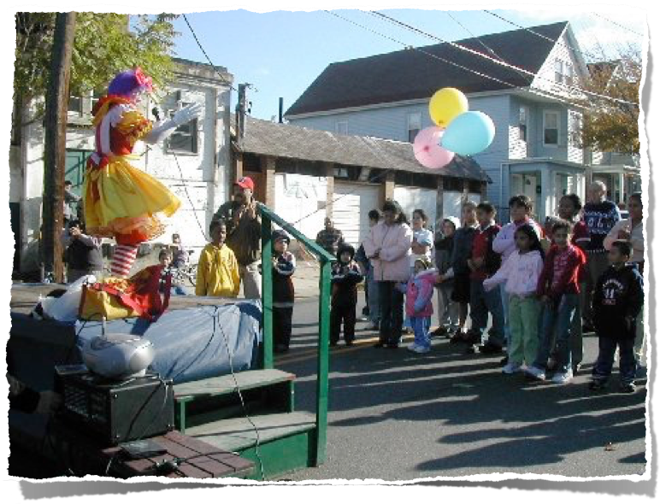
Notes:
Social networks offer value and define the qualitative interaction of any community.
What does "social capital" mean? The central premise of social capital is that social networks have value. Social capital refers to the collective value of all "social networks" [who people know] and the inclinations that arise from these networks to do things for each other, reciprocal behaviors, referred to as "norms of reciprocity".
How does social capital work? The term social capital emphasizes not just warm and cuddly feelings, but a wide variety of specific benefits that flow from the trust, reciprocity, information, and cooperation associated with social networks. Social capital creates value for the people who are connected and for bystanders, as well.

Slide 38
Social Networks Rooted in Reciprocity
Mutual Benefits
Notes:
The core insight of the concept of social capital is that, like tools (physical capital) and training (human capital), social connections have value for quality of life.
The collective value of people in social networks and the benefits from these networks influence reciprocal behaviors: Doing things for each other.
This shared value is called Social Capital.

Slide 39
Quality of Life Impaired By:
Fragmentation
Distraction
Isolation
Disconnection
Stress
Notes:
Increasingly disconnected
Reduced interaction with community
Community fragmentation
Congregations are part of this trend
We have become increasingly disconnected from family, friends, neighbors, and social structures, whether the PTA, church, recreation clubs, political parties, or bowling leagues.
Our shrinking access to the "social capital" reward of communal activity and community sharing is a serious threat to our civic and personal health.
Congregations are part of this trend of decline shared with all other groups.
it. Some credit Internet-based
social networking for bolstering youthful interest in politics and community life, but the advent of the well-known social-networking sites
Facebook (2004) and Twitter (2006) occurred years after the initial
upturn in civic engagement by young people.
Gen-X (20 year olds and younger) are more socially connected.

Slide 40
Reciprocity Is
Life-Giving
Notes:
Though the word Reciprocity does not occur in the Bible, the concept certainly does.

Slide 41
Numbers 35.34
World
+ God
Neighbors
Notes:
“Don’t desecrate the land in which you live. I live here too—I, GOD, live in the same neighborhood with the People of Israel.”

Slide 42
Jeremiah 29.7
Blessings
Notes:
Make yourselves at home there and work for the country’s welfare.
Pray for Babylon’s well-being. If things go well for Babylon, things will go well for you.”

Slide 43
Luke 6:31
Respect and Love
Notes:
Do to others as you would have them do to you.

Slide 44
1Corinthians 9.9-11
Justice and Equality
Notes:
Moses wrote, “Don’t muzzle an ox to keep it from eating the grain when it’s threshing.” Do you think Moses’ primary concern was the care of farm animals? Don’t you think his concern extends to us? Of course. Farmers plow and thresh expecting something when the crop comes in. So if we have planted spiritual seed among you, is it out of line to expect a meal or two from you?

Slide 45
Galatians 6.7
Return on Goodness
Notes:
Don’t be misled: No one makes a fool of God. What a person plants, he will harvest.
v 7
So let’s not allow ourselves to get fatigued doing good. At the right time we will harvest a good crop if we don’t give up, or quit.

Slide 46
We love to count!
(We even have a book of the Bible called Numbers!)
Notes:
Drawing on vast data from the Roper Social and Political Trends and the DDB Needham Life Style, we learn about Americans' changing behavior over the past thirty years.
We have become increasingly disconnected from family, friends, neighbors, and social structures, whether the PTA, church, recreation clubs, political parties, or bowling leagues.
Our shrinking access to the "social capital" reward of communal activity and community sharing is a serious threat to our civic and personal health.
Congregations are part of this trend of decline shared with all other groups.

Slide 47
Groups
Groups include all voluntary associations such as the PTA, AMA, synagogues, churches, recreation clubs, fraternal organizations, political parties, bowling leagues, etc.
(Illustrates comparative data)
Notes:
Groups include all voluntary associations such as the PTA, AMA, synagogues, churches, recreation clubs, political parties, and bowling leagues, etc.
Slide Point:
The point is that there are more groups, but dramatically fewer members.
Based on statistical research published of Dr. Robert D. Putnam (Harvard University) in his Bowling Alone: The Collapse and Revival of American Community (2001) and Better Together: Restoring the American Community (2004). Drawing on vast data from the Roper Social and Political Trends and the DDB Needham Life Style -- surveys that report in detail on Americans' changing behavior over the past twenty-five years -- Putnam shows how we have become increasingly disconnected from family, friends, neighbors, and social structures, whether the PTA, church, recreation clubs, political parties, or bowling leagues. Our shrinking access to the "social capital" that is the reward of communal activity and community sharing is a serious threat to our civic and personal health. Congregations are part of this trend of decline shared with all other groups.
Source Data:
http://www.thearda.com/Denoms/Families/Trees/familytree_presbyterian.asp
For more information and the missional implications for the PC(USA), please contact the author:
Dr. Kevin Yoho, General Presbyter
Newark Presbytery
973.429.2500 office
201.207.1544 mobile
Kevin@newarkpresbytery.org

Slide 48
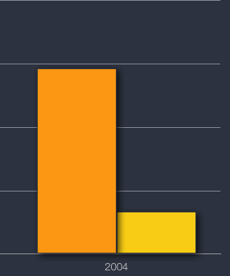
Diminished Group Value, Participation
Groups
Stressors exist for all volunteer associations, including churches:
More Groups
Fewer Members
Members
Notes:
Stressors exist for all volunteer associations, including churches:
More Groups
Fewer Members

Slide 49
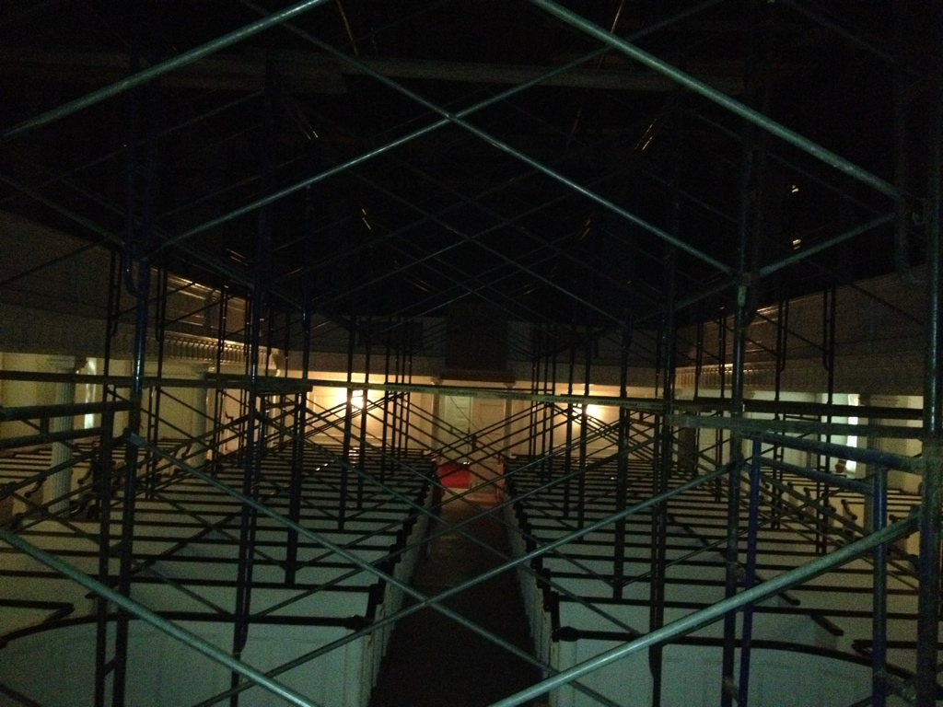
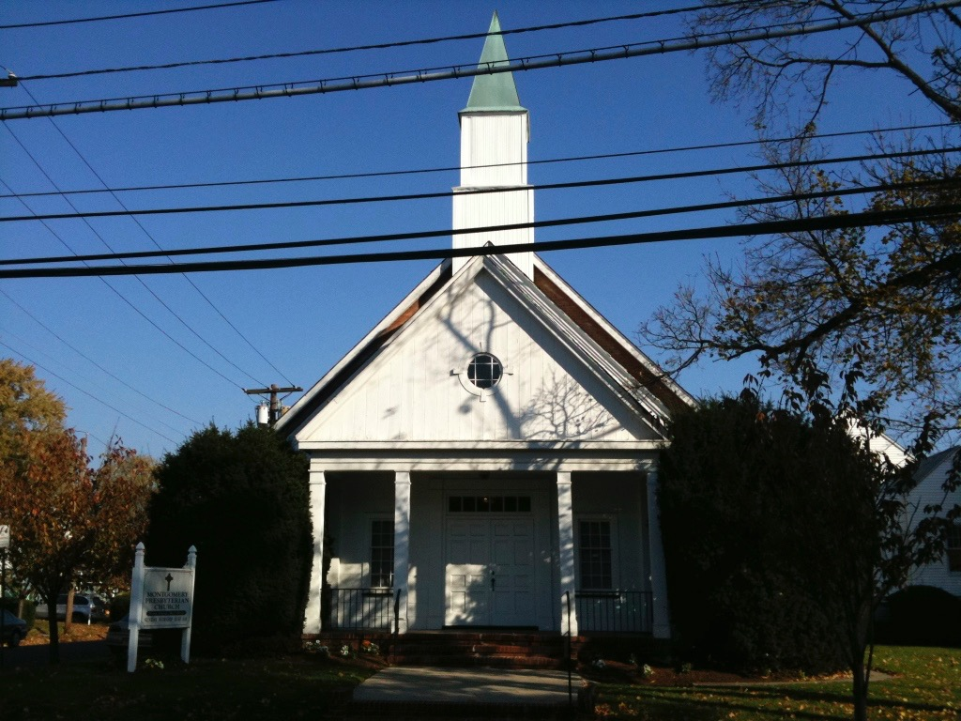
Notes:
Proxy for effectiveness is to measure group membership.
One indicator of volunteerism’s effectiveness is to measure group membership.
Groups include all voluntary associations such as the PTA, AMA, synagogues, mosques, recreation clubs, political parties, bowling leagues, etc., and the church with all its tribes and varieties.
The research of Dr. Robert Putnam, Harvard University, helps us quantify forty years of social capital in North America in his two best sellers, Bowling Alone (2001) and Better Together (2004).
One indicator of volunteerism’s effectiveness is to measure group membership.
Groups include all voluntary associations such as the PTA, AMA, synagogues, mosques, recreation clubs, political parties, bowling leagues, etc., and the church with all its tribes and varieties.

Slide 50
`
Notes:
Slide Point:
The point is that Presbyterian Church membership decline is NOT a Presbyterian problem, but a sociological one.
It is critical in the transformation process to put “our” decline in its social context so that congregational responses to this decline can be relevant, effective, and contextually relevant. The negativity and defensiveness that often describes the PC(USA) membership and leadership can be mitigated and even turned around to positive and creative responses when we realize that only through contextual and collaborative transformation efforts can these trends be reversed.
Based on statistical research published of Dr. Robert D. Putnam (Harvard University) in his Bowling Alone: The Collapse and Revival of American Community (2001) and Better Together: Restoring the American Community (2004). Drawing on vast data from the Roper Social and Political Trends and the DDB Needham Life Style -- surveys that report in detail on Americans' changing behavior over the past twenty-five years -- Putnam shows how we have become increasingly disconnected from family, friends, neighbors, and social structures, whether the PTA, church, recreation clubs, political parties, or bowling leagues. Our shrinking access to the "social capital" that is the reward of communal activity and community sharing is a serious threat to our civic and personal health. Congregations are part of this trend of decline shared with all other groups.
Source Data:
Presbyterian Church data is in millions of members, composited to include various streams of PC(USA). data sets found at: datahttp://www.thearda.com/Denoms/Families/Trees/familytree_presbyterian.asp
All Other Group Data: data is 10x million of members, Robert Putnam, data sets found at: http://www.bowlingalone.com/data.php3
Gen X-ers increasingly civicly engaged?
Posted on October 27, 2011 by socialcapital | 1 Comment
The Longitudinal Study of American Youth at University of Michigan has issued a new report “The Generation X Report: Active, Balanced, and Happy: These young Americans are not bowling alone“, whose conclusions are evident from its title.
Data they use: the LSAY began in 1987 with a national sample of 7th and 10th grade students in 50 U.S. public school systems; these 5,900 students were tracked for 6 years. Then 95% of them were relocated in 2007 and interviewing has resumed annually for the last 4 years. Survey participants are now 36 and 39 years old.
Some of their evidence:
“One in three Generation X young adults is an active member of a church or religious organization and almost all of these young adults report attending one or more church or religious activities or events each week. Thirty percent of Generation X young adults indicated that they are active members of a professional, business, or union organization, which provides additional opportunities for social interactions. Seventeen percent of all LSAY young adults are active members of a parent-teacher organization and 24% of the parents of minor children indicated that they are active in a school-based parent-teacher organization. Seventeen percent of Generation X young adult say that they are active in one or more community service groups and 29% report that they do some hours of volunteer work in their community each month. Four percent were active members of a book group and 3% indicated that they were active members of an environmental group….
For more information and the missional implications for the PC(USA), please contact the author:
Dr. Kevin Yoho, General Presbyter
Newark Presbytery
973.429.2500 office
201.207.1544 mobile
kevin@newarkpresbytery.org

Slide 51
Membership
Notes:
Slide Point:
The point is that Presbyterian Church membership decline is NOT a Presbyterian problem, but a sociological one.
It is critical in the transformation process to put “our” decline in its social context so that congregational responses to this decline can be relevant, effective, and contextually relevant. The negativity and defensiveness that often describes the PC(USA) membership and leadership can be mitigated and even turned around to positive and creative responses when we realize that only through contextual and collaborative transformation efforts can these trends be reversed.
Based on statistical research published of Dr. Robert D. Putnam (Harvard University) in his Bowling Alone: The Collapse and Revival of American Community (2001) and Better Together: Restoring the American Community (2004). Drawing on vast data from the Roper Social and Political Trends and the DDB Needham Life Style -- surveys that report in detail on Americans' changing behavior over the past twenty-five years -- Putnam shows how we have become increasingly disconnected from family, friends, neighbors, and social structures, whether the PTA, church, recreation clubs, political parties, or bowling leagues. Our shrinking access to the "social capital" that is the reward of communal activity and community sharing is a serious threat to our civic and personal health. Congregations are part of this trend of decline shared with all other groups.
Source Data:
Presbyterian Church data is in millions of members, composited to include various streams of PC(USA). data sets found at: datahttp://www.thearda.com/Denoms/Families/Trees/familytree_presbyterian.asp
All Other Group Data: data is 10x million of members, Robert Putnam, data sets found at: http://www.bowlingalone.com/data.php3
Gen X-ers increasingly civicly engaged?
Posted on October 27, 2011 by socialcapital | 1 Comment
The Longitudinal Study of American Youth at University of Michigan has issued a new report “The Generation X Report: Active, Balanced, and Happy: These young Americans are not bowling alone“, whose conclusions are evident from its title.
Data they use: the LSAY began in 1987 with a national sample of 7th and 10th grade students in 50 U.S. public school systems; these 5,900 students were tracked for 6 years. Then 95% of them were relocated in 2007 and interviewing has resumed annually for the last 4 years. Survey participants are now 36 and 39 years old.
Some of their evidence:
“One in three Generation X young adults is an active member of a church or religious organization and almost all of these young adults report attending one or more church or religious activities or events each week. Thirty percent of Generation X young adults indicated that they are active members of a professional, business, or union organization, which provides additional opportunities for social interactions. Seventeen percent of all LSAY young adults are active members of a parent-teacher organization and 24% of the parents of minor children indicated that they are active in a school-based parent-teacher organization. Seventeen percent of Generation X young adult say that they are active in one or more community service groups and 29% report that they do some hours of volunteer work in their community each month. Four percent were active members of a book group and 3% indicated that they were active members of an environmental group….
For more information and the missional implications for the PC(USA), please contact the author:
Dr. Kevin Yoho, General Presbyter
Newark Presbytery
973.429.2500 office
201.207.1544 mobile
kevin@newarkpresbytery.org

Slide 52
Causation or Correlation?
Decline may have multiple causes, only one key correlation.
Notes:
The membership decline of volunteer associations (such as the church) correlates to their reduced community involvement, caused by a withdrawal of social capital.
In order for congregations to grow deep and wide, they must increase their involvement in their community by re-investing their social capital (spiritual, emotional, physical, financial, etc.)

Slide 53
Membership
Community Engagement
Notes:
Slide Point:
The point is that Presbyterian Church membership decline is NOT a Presbyterian problem, but a sociological one.
It is critical in the transformation process to put “our” decline in its social context so that congregational responses to this decline can be relevant, effective, and contextually relevant. The negativity and defensiveness that often describes the PC(USA) membership and leadership can be mitigated and even turned around to positive and creative responses when we realize that only through contextual and collaborative transformation efforts can these trends be reversed.
Based on statistical research published of Dr. Robert D. Putnam (Harvard University) in his Bowling Alone: The Collapse and Revival of American Community (2001) and Better Together: Restoring the American Community (2004). Drawing on vast data from the Roper Social and Political Trends and the DDB Needham Life Style -- surveys that report in detail on Americans' changing behavior over the past twenty-five years -- Putnam shows how we have become increasingly disconnected from family, friends, neighbors, and social structures, whether the PTA, church, recreation clubs, political parties, or bowling leagues. Our shrinking access to the "social capital" that is the reward of communal activity and community sharing is a serious threat to our civic and personal health. Congregations are part of this trend of decline shared with all other groups.
Source Data:
Presbyterian Church data is in millions of members, composited to include various streams of PC(USA). data sets found at: datahttp://www.thearda.com/Denoms/Families/Trees/familytree_presbyterian.asp
All Other Group Data: data is 10x million of members, Robert Putnam, data sets found at: http://www.bowlingalone.com/data.php3
Gen X-ers increasingly civicly engaged?
Posted on October 27, 2011 by socialcapital | 1 Comment
The Longitudinal Study of American Youth at University of Michigan has issued a new report “The Generation X Report: Active, Balanced, and Happy: These young Americans are not bowling alone“, whose conclusions are evident from its title.
Data they use: the LSAY began in 1987 with a national sample of 7th and 10th grade students in 50 U.S. public school systems; these 5,900 students were tracked for 6 years. Then 95% of them were relocated in 2007 and interviewing has resumed annually for the last 4 years. Survey participants are now 36 and 39 years old.
Some of their evidence:
“One in three Generation X young adults is an active member of a church or religious organization and almost all of these young adults report attending one or more church or religious activities or events each week. Thirty percent of Generation X young adults indicated that they are active members of a professional, business, or union organization, which provides additional opportunities for social interactions. Seventeen percent of all LSAY young adults are active members of a parent-teacher organization and 24% of the parents of minor children indicated that they are active in a school-based parent-teacher organization. Seventeen percent of Generation X young adult say that they are active in one or more community service groups and 29% report that they do some hours of volunteer work in their community each month. Four percent were active members of a book group and 3% indicated that they were active members of an environmental group….
For more information and the missional implications for the PC(USA), please contact the author:
Dr. Kevin Yoho, General Presbyter
Newark Presbytery
973.429.2500 office
201.207.1544 mobile
kevin@newarkpresbytery.org

Slide 54
A faith community's community engagement correlates to membership.

Slide 55
Community Capacity Matters to Church
Sense of Community
Community Engagement
Notes:
Study of community connections is emergent
Community effects often overlooked factors in quality of life studies
Degree to which people are imbedded in their communities may escape the attention of those who seek to discover why some neighborhoods thrive while others despair
Improving quality of life is partially tied into how engaged people are in their community and how connected they feel with that community
Community engagement (CE) and sense of community (SC) are core elements of community connections
Community engagement is the degree to which an individual is active with other individuals and groups around particular community events and issues; CE uses formal networks as a vehicle for connections
Sense of community is the degree to which an individual is affectively connected with others; SC uses informal networks as a vehicle for connections
Community engagement and sense of community are interrelated
Each informs and facilitates the other
Each has a unique contribution to understanding community connections and in combination they provide a broad understanding of the instrumental and affective dimensions of community life

Slide 56
Your Neighbors Self-Identification
Notes:
The ARIS (AMERICAN RELIGIOUS IDENTIFICATION SURVEY (ARIS) 2008) The challenge to Christianity in American society does not come from other world religions or new religious movements (NRMs) but rather from a rejection of all organized religions.

Slide 57
Revolution Framework Context
Framework | Context of Decline
Church is a victim Capacity impaired | Denominational Organizational Theological Tactical
Church is change agent Capacity increases | Sociological Ecological Spiritual Strategic

Slide 58
Revolution Framework Reason
Framework | Reason for Decline
Church is a victim Capacity impaired | Death Transfer Role Removal People Just Drifted Away Our Neighbors Aren’t Religious
Church is change agent Capacity increases | Focus is Church Disconnect from Community Withdraw Social Capital Confuse Equity Holders with Stakeholders

Slide 59
Revolution Framework Remedy
Framework | Remedy for Decline
Church is a victim Capacity impaired | Community -> Church More Evangelism Change Leaders Change Theology
Church is change agent Capacity increases | Church -> Community Volunteerism Unique Mission Redeploy Assets Community Re-Engagement

Slide 60
Revolution Framework Behavior
Framework | Behaviors to Increase
Church is a victim Capacity impaired | Use Same Skills Work Harder Inward Focus Stay the Course (or) Give Up
Church is change agent Capacity increases | Innovation New Competencies Work Smarter Focus Ministry Outside Love the World in Jesus’ Name

Slide 61
Incumbent vs Emergent
Hold on to what you have (had?) or
Experience the living God to through an innovative new church
Notes:
Are we as disciples of Christ going to be like the pharisees who wanted to hold on to what they had, the incumbent, or see the big picture and allow our experience with the living God to live through a innovative church?
This is a question I've been asking myself while reading Seeing What's Next: Using the Theories of Innovation to Predict Industry Change by Clayton M. Christensen, author of The Innovator's Dilemma and The Innovator's Solution. The book's tone ranges from brain-achingly esoteric to enlighteningly accessible, and while I might not do Christensen justice, a kernel of his thesis is worth distilling here in reference to search engines and their developments for both consumers and marketers.
The goal of the book is to present a theory that objectively evaluates innovation, and the theory addresses a number of angles: whether the innovation is sustaining or disruptive, whether incumbent companies or startups will fare best in capitalizing on the changes, and what types of consumers are targeted by the innovation. Christensen denotes three types of consumers served by various innovations:
Non-consumers: They're not using the product or service at all. For our purposes, these are people who are getting by in their daily life without search engines, or they're marketers who have yet to dabble in search engine marketing. You might also refer to such people as heathens.
Undershot customers: These are the consumers who are first in line to try out new services on mobile devices, and they're the search marketers who are clamoring for demographic and behavioral targeting, integrated measurement of online and offline campaigns, and branding measurement. They're early adopters, and Christensen implies they're overrepresented in trend stories.
Overshot customers: they're onboard, but they don't care for the bells and whistles. They're the consumers who never even once clicked on a search engine "advanced" link, and they're the marketers who want a return on investment but don't care about breaking new ground. They've said "enough, already," and just want the quickest, cheapest, most convenient way to accomplish their goals.
Christensen notes that undershot customers are often served by sustaining innovations from incumbent leaders. Far more interesting to Christensen are the non-consumers and overshot customers. With non-consumers in particular, there's tremendous market opportunity, but originally the market's going to be small enough that incumbents will not take notice. For instance, a $20 million opportunity within a couple of years is a pittance to Microsoft or Google but a major windfall for a startup.

Slide 62
Equilibrium Fosters Nostalgia
It’s not 1968, 1980, or even 2010 anymore
Get ready for change
Choice is yours to make

Slide 63
Renew Mindset, Grow, and Change
Adapt to new realities
Embrace a Return on Innovation (not investment) model
Congregations can choose growth of context, ecologies, communities, and ministry

Slide 64
Incentives for Destination Ministry
Generate feedback for new models
Incentivize pastors and church leaders for innovating
Resist merely adjusting for today's world
Focus on tomorrow's world
Notes:
Promising reversal. One in three Generation X young adults is an active member of a church or religious organization and almost all of these young adults report attending one or more church or religious activities or events each week.
We have written about how the generation below Gen-X (those in their late 20s) are more engaged now than a generation ago (See Sander-Putnam “Still Bowling Alone“).

Slide 65
Revolutionary Measures
The value of an organization's ministry per person impacted
Sense of Community
Notes:
Stressing that the point is innovation. A dynamic economy requires growing companies—those that increase their value-added contribution over time. To maximize this, a company should prioritize the innovation that leads to the greatest value. That value must be measured across all stakeholders.
Innovation should have the widest possible market. As the late C. K. Prahalad pointed out, the "bottom of the pyramid" is a market and not a social problem. In a recent talk at MIT, Infosys founder Narayana Murthy put it this way: "Technological innovation is all about reducing cost, reducing cycle time, making life more comfortable. Therefore: who needs new technology more than the poor?

Slide 66
Revolutionary Measures
The number of people impacted by your ministry
Community Engagement
Notes:
Stressing that the point is innovation. A dynamic economy requires growing companies—those that increase their value-added contribution over time. To maximize this, a company should prioritize the innovation that leads to the greatest value. That value must be measured across all stakeholders.
Innovation should have the widest possible market. As the late C. K. Prahalad pointed out, the "bottom of the pyramid" is a market and not a social problem. In a recent talk at MIT, Infosys founder Narayana Murthy put it this way: "Technological innovation is all about reducing cost, reducing cycle time, making life more comfortable. Therefore: who needs new technology more than the poor?

Slide 67
Revolutionary Measures
The frequency with which the group innovates to connect
Sustainable Reciprocity
Notes:
Stressing that the point is innovation. A dynamic economy requires growing companies—those that increase their value-added contribution over time. To maximize this, a company should prioritize the innovation that leads to the greatest value. That value must be measured across all stakeholders.
Innovation should have the widest possible market. As the late C. K. Prahalad pointed out, the "bottom of the pyramid" is a market and not a social problem. In a recent talk at MIT, Infosys founder Narayana Murthy put it this way: "Technological innovation is all about reducing cost, reducing cycle time, making life more comfortable. Therefore: who needs new technology more than the poor?

Slide 68
Reciprocal Church Revolution
With Community Impact
A Community Destination
What do you think?
How will your church earn the right to become a community destination
and impact the world?
Notes:
That’s how the church can become a community destination and impact the world.

Slide 69
Reciprocal Revolution: Making Your Church
A Community Destination
With Community Impact

Slide 70
Reciprocal Revolution
Resources From Today's Workshop available online.
Thank you for being with us today!
www.reiprocalrevo.com

